Slide 1





Slide 2




Sorting

Slide 3
W8: Searching and Sorting
WIA1002/ WIB1002/WXES1117 :
Data Structures

Slide 4


Looking for a missing cat ....
1
2
3
4
5

Slide 5
Searching
Searching is the process of finding a target element among a group of items (the search pool), or determining that it isn't there.
This requires repetitively comparing the target to candidates in the search pool.
An efficient sort performs no more comparisons than it has to.
The size of the search pool is a factor.

Slide 6
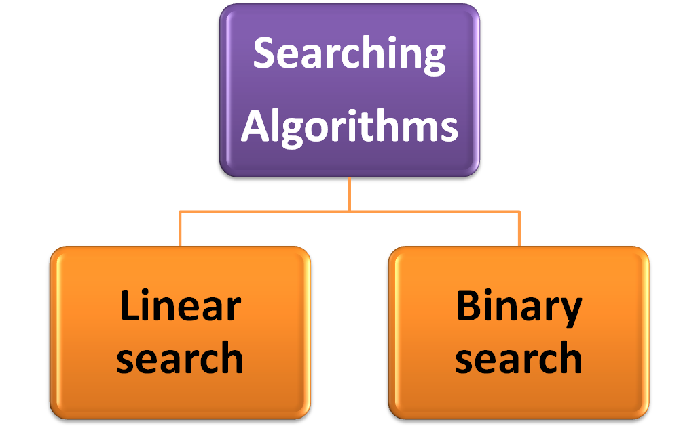

Slide 7
1. Linear Search
A linear search simply examines each item in the search pool, one at a time, until either the target is found or until the pool is exhausted.
This approach does not assume the items in the search pool are in any particular order.
We just need to be able to examine each element in turn (in a linear fashion).
It's fairly easy to understand, but not very efficient.

Slide 8
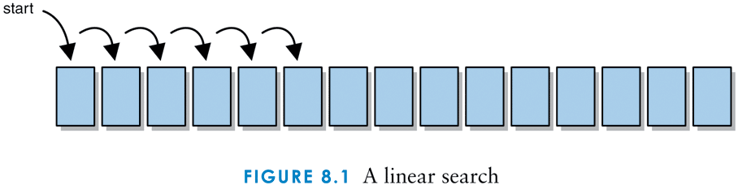
Linear search

Slide 9
Example 1 : Looking for a missing cat ....
1
2
3
4
5
Linear search

Slide 10
The Comparable Interface
We want to define the algorithms such that they can search any set of objects
Therefore we will search objects that implement the Comparable interface
It contains one method, compareTo, which is designed to return an integer that specifies the relationship between two objects:
obj1.compareTo(obj2)
This call returns a number less than, equal to, or greater than 0 if obj1 is less than, equal to, or greater than obj2, respectively

Slide 11
The Comparable Interface
All of the methods presented in this chapter are static methods.
This class makes use of the generic type T
For these methods, we make the further distinction that T extends Comparable
public static <T extends Comparable<? super T>> boolean linearSearch(T[] data, int min, int max, T target)
It means that T must implement Comparable<T itself or one of T's superclasses>

Slide 12
What is bounded and unbounded wildcards in Generics
<?> unbounded wildcard (represents any object type) -For example List<?> can represent any List e.g. List<String> or List<Integer> its provides highest level of flexibility on passing method argument.
<? extends T> upper bounded where all Types must be sub-class of T
<? super T?> lower bound wildcard (unknown supertype of T) where all Types required to be super class of T
*bounded wildcards provides limited flexibility within bound
http://javarevisited.blogspot.my/2012/04/what-is-bounded-and-unbounded-wildcards.html

Slide 13
The Comparable Interface
This means that the array of type T must contain objects that are comparable to each other
This may mean that they are of the same class or descendants of the same ancestor
A call to such a method would appear as:
SortingandSearching.linearSearch(
targetarray, min, max,target)

Slide 14
Algorithm: Linear search
/**
* Searches the specified array of objects using a linear search
* algorithm.
*
* @param data the array to be sorted
* @param min the integer representation of the minimum value
* @param max the integer representation of the maximum value
* @param target the element being searched for
* @return true if the desired element is found
*/
public static <T extends Comparable<? super T>> boolean linearSearch (T[] data, int min, int max, T target)
{
int index = min;
boolean found = false;
while (!found && index <= max)
{
if (data[index].compareTo(target) == 0)
found = true;
index++;
}
return found;
}

Slide 15
2. Binary search
If the search pool is sorted, then we can be more efficient than a linear search.
A binary search eliminates large parts of the search pool with each comparison.
Instead of starting the search at one end, we begin in the middle.
If the target isn't found, we know that if it is in the pool at all, it is in one half or the other.
We can then jump to the middle of that half, and continue similarly.

Slide 16
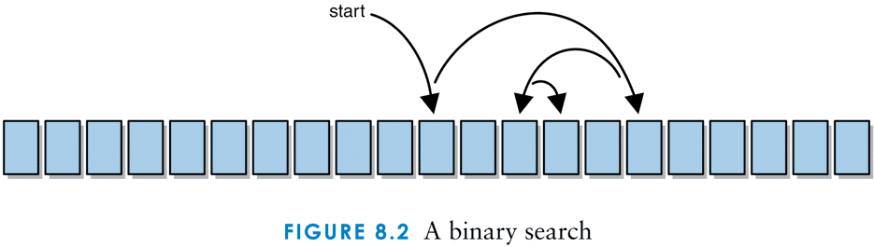
Binary search

Slide 17
Example 2: Searching sorted numbers
For example, find the number 67 in the following sorted list of numbers:
10 12 18 22 31 34 40 46 59 67 69 72 80 84 98
Search begins with middle value (e.g. 46).
46 is not target, continue searching. Because list is sorted, 67 should be in the next 2nd half of data.
10 12 18 22 31 34 40 46 59 67 69 72 80 84 98
72 is not target, continue searching. Eliminate all values larger than 72.
10 12 18 22 31 34 40 46 59 67 69 72 80 84 98

Slide 18
Binary search
A binary search algorithm is often implemented recursively.
Each recursive call searches a smaller portion of the search pool.
The base case of the recursion is running out of viable candidates to search, which means the target is not in the search pool.
At any point there may be two "middle" values, in which case either could be used.

Slide 19
Algorithm: binarySearch
/*** Searches the specified array of objects using a binary search
* algorithm.
*
* @param data the array to be sorted
* @param min the integer representation of the minimum value
* @param max the integer representation of the maximum value
* @param target the element being searched for
* @return true if the desired element is found
*/
public static <T extends Comparable<? super T>> boolean binarySearch (T[] data, int min, int max, T target)
{
boolean found = false; //assume item is not found
int midpoint = (min + max) / 2; // determine the midpoint
if (data[midpoint].compareTo(target) == 0) //compare midpoint with target, if equal, return true
found = true;
else if (data[midpoint].compareTo(target) > 0) // goes to left side
{
if (min <= midpoint - 1)
found = binarySearch(data, min, midpoint - 1, target);
}
else if (midpoint + 1 <= max) //goes to the right side
found = binarySearch(data, midpoint + 1, max, target);
return found; }

Slide 20
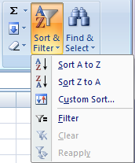
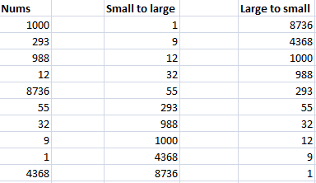
Sorting

Slide 21
Sorting
Sorting is the process of arranging a group of items into a defined order based on particular criteria
2 categories of sorting algorithms :
  Sequential sort
    n² comparisons to sort n elements
  Logarithmic sort
    nlog₂n comparisons to sort n element
  Sequential versus Logarithmic sort? Which one perform better

Slide 22
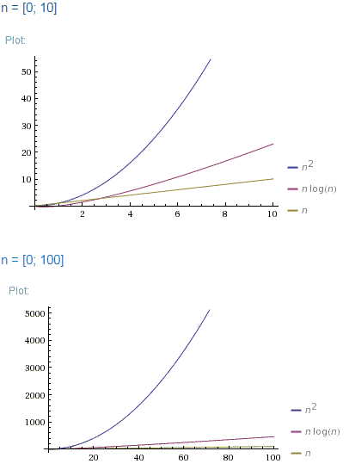
O(N*log(N)) is far better than O(N^2)

Slide 23
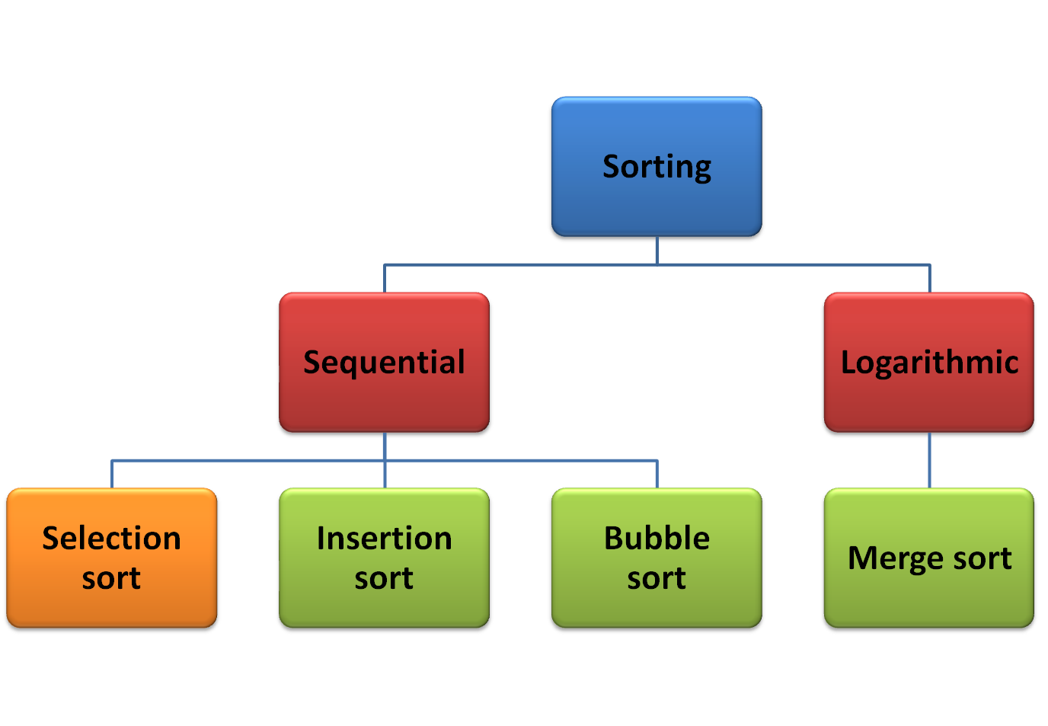

Slide 24
1. Selection sort
Selection sort orders a list of values by repetitively putting a particular value into its final position.
Search strategy:
  Scan list, find the smallest value in the list
  switch it with the value in the first position
  find the next smallest value in the list
  switch it with the value in the second position
  repeat until all values are in their proper places

Slide 25
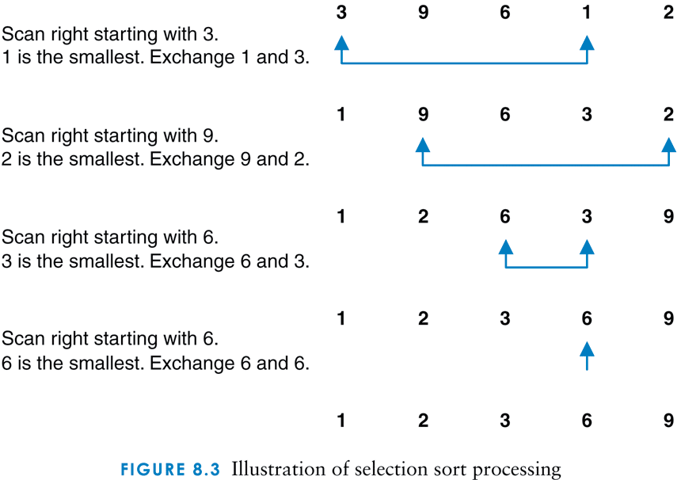
Illustration of selection sort

Slide 26
Algorithm: Selection Sort
/**
* Sorts the specified array of integers using the selection
* sort algorithm.
*
* @param data the array to be sorted
*/
public static <T extends Comparable<? super T>> void selectionSort (T[] data)
{
int min;
T temp;
for (int index = 0; index < data.length-1; index++)
{
min = index;
for (int scan = index+1; scan < data.length; scan++)
if (data[scan].compareTo(data[min])<0)
min = scan;
/** Swap the values */
temp = data[min];
data[min] = data[index];
data[index] = temp;
}
}

Slide 27
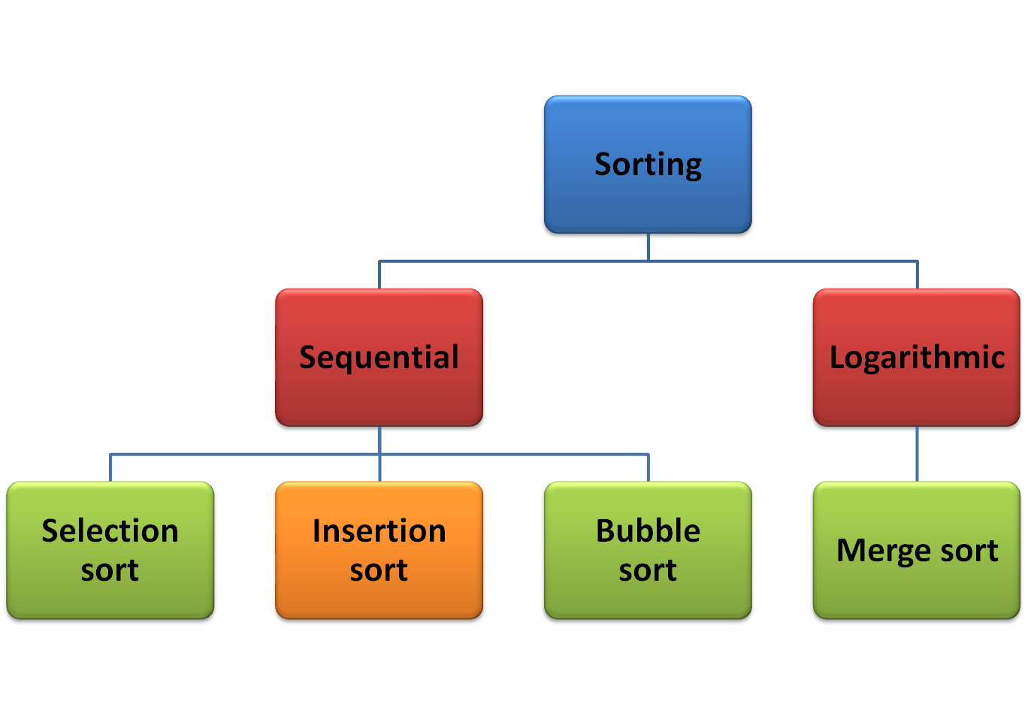

Slide 28
2. Insertion sort
Insertion sort orders a list of values by repetitively inserting a particular value into a subset of the list that has already been sorted.
Search strategy:
  consider the first item to be a sorted sublist of length 1
  insert the second item into the sorted sublist, shifting the first item if needed
  insert the third item into the sorted sublist, shifting the other items as needed
  repeat until all values have been inserted into their proper positions

Slide 29
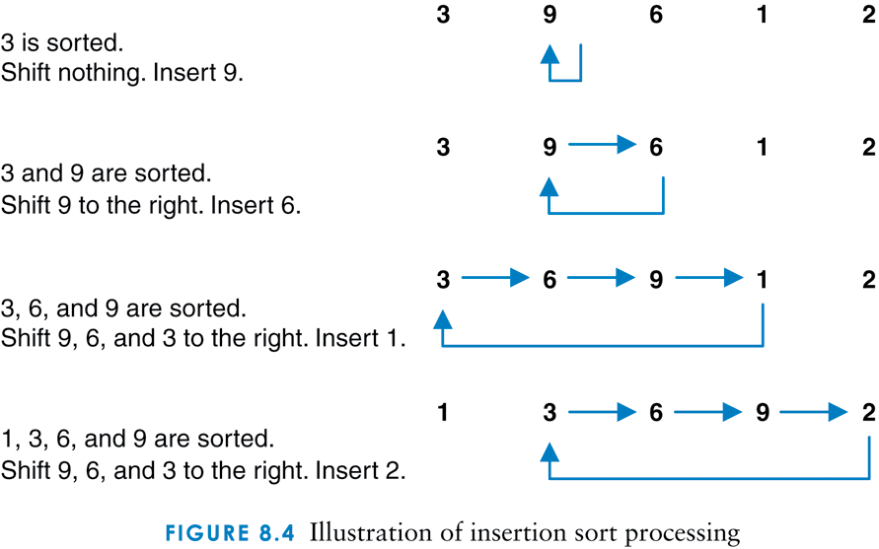

Illustration of insertion sort

Slide 30
Algorithm: Insertion sort
/**
* Sorts the specified array of objects using an insertion
* sort algorithm.
*
* @param data the array to be sorted
*/
public static <T extends Comparable<? super T>> void insertionSort (T[] data)
{
for (int index = 1; index < data.length; index++)
{
T key = data[index];
int position = index;
// Shift larger values to the right by continuously compare backward
while (position > 0 && data[position-1].compareTo(key) > 0)
{
data[position] = data[position-1];
position--;
}
data[position] = key; //set the value of key at stop position index
}
}

Slide 31
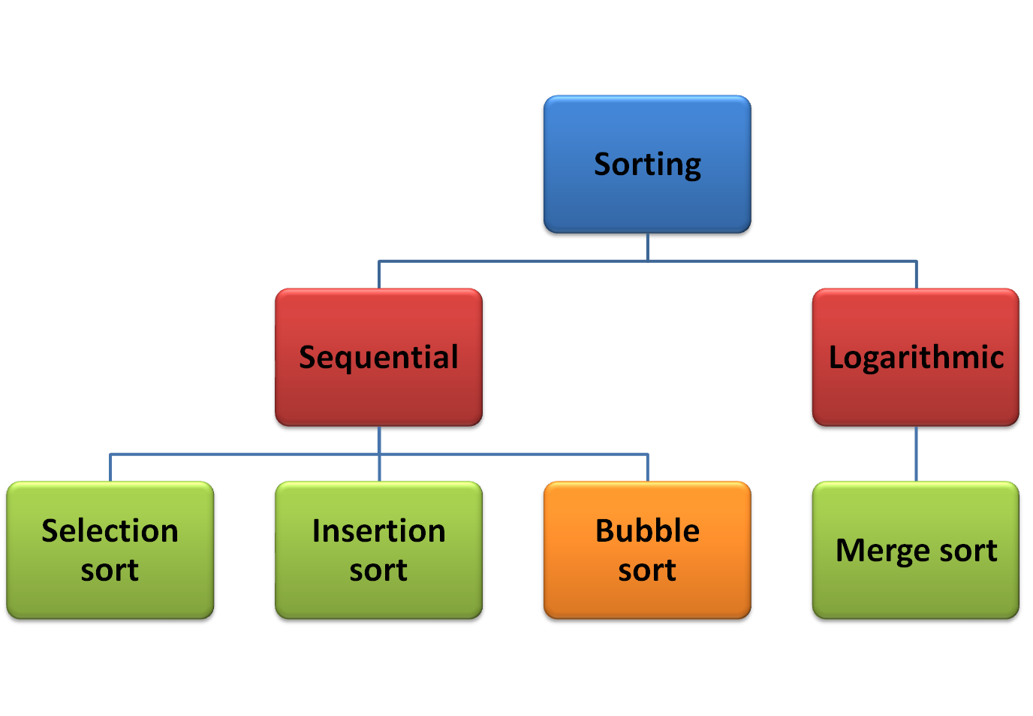

Slide 32
3. Bubble sort
Bubble sort orders a list of values by repetitively comparing neighboring elements and swapping their positions if necessary
Search strategy:
  scan the list, exchanging adjacent elements if they are not in relative order; this bubbles the highest value to the top
  scan the list again, bubbling up the second highest value
  repeat until all elements have been placed in their proper order

Slide 33
Bubble Sort Animation
http://www.cs.armstrong.edu/liang/animation/BubbleSortAnimation.html

Slide 34
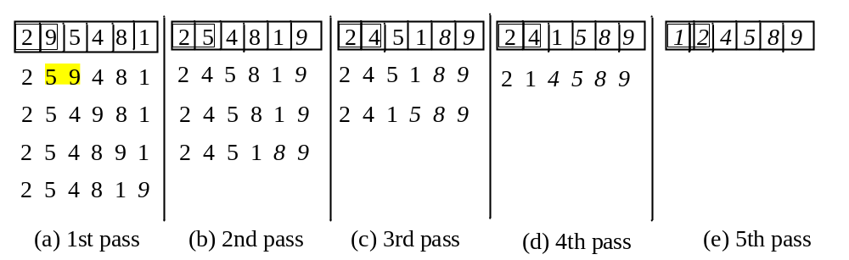
Bubble Sort
1st pass places largest num as last in an array.
2nd pass, no need to consider last element as it is
the largest.
3rd pass, no need to consider two last elements as
they have been sorted.
so k^{th} pass, no need to consider k-1 elements,
because they’re already ordered.
Sample code:
http://www.cs.armstrong.edu/liang/intro9e/html/BubbleSort.html

Slide 35
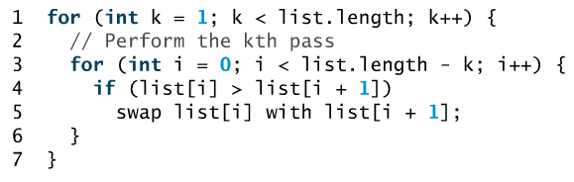
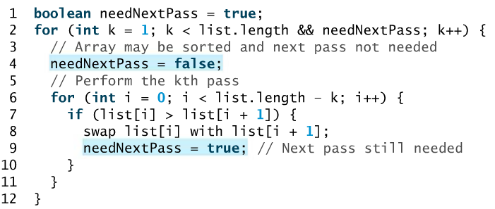
Algorithm: Bubble sort
If no swap takes place in a pass, there is no need to perform the next pass, because all elements are sorted. So use, boolean operator to improve this algorithm.
By default each for loop will set needNextPass to false
If swap still occurs it means that the list is not yet sort out
So we set the flag to true so that it will perform the next pass

Slide 36
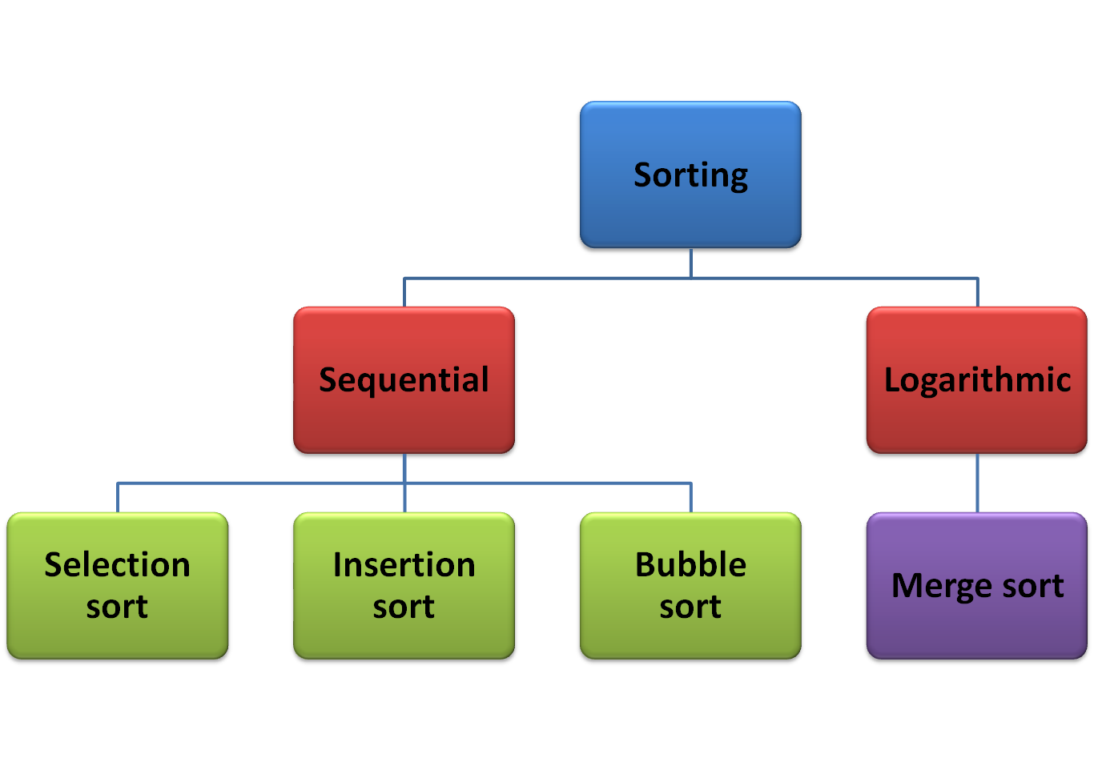

Slide 37
1. Merge sort
Merge sort orders a list of values by recursively dividing the list in half until each sub-list has one element, then recombining. (uses divide & conquer)
Search strategy:
  divide the list into two roughly equal parts
  recursively divide each part in half, continuing until a part contains only one element
  merge the two parts into one sorted list
  continue to merge parts as the recursion unfolds

Slide 38
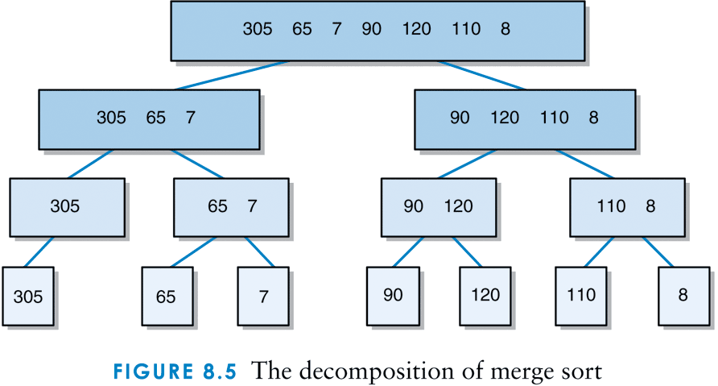
Decomposition of merge sort

Slide 39
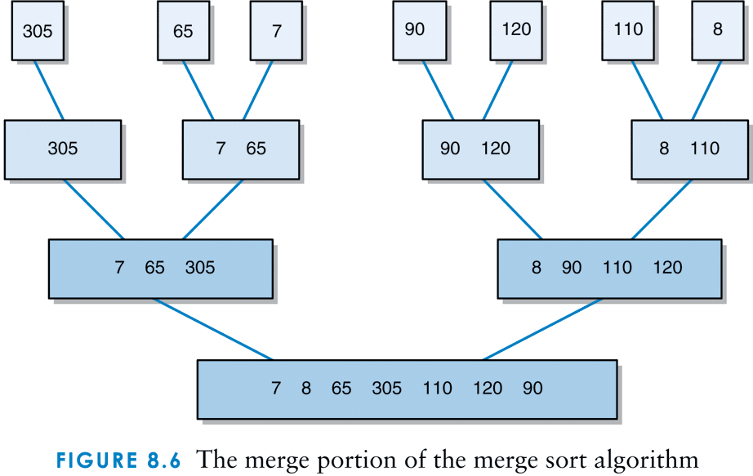
Merge portion of merge sort

Slide 40
Algorithm: Merge sort
/**
* Sorts the specified array of objects using the merge sort
* algorithm.
*
* @param data the array to be sorted
* @param min the integer representation of the minimum value
* @param max the integer representation of the maximum value
*/
public static <T extends Comparable<? super T>> void mergeSort (T[] data, int min, int max)
{
T[] temp;
int index1, left, right;
/** return on list of length one */
if (min==max)
return;
/** find the length and the midpoint of the list */
int size = max - min + 1;
int pivot = (min + max) / 2;
temp = (T[])(new Comparable[size]);

Slide 41
  /*recursively divide each part in half, continuing until a part contains only one element*/
mergeSort(data, min, pivot); // sort left half of list
mergeSort(data, pivot + 1, max); // sort right half of list
/** copy sorted data into workspace */
for (index1 = 0; index1 < size; index1++)
temp[index1] = data[min + index1];
/** merge the two sorted lists */
left = 0;
right = pivot - min + 1;
for (index1 = 0; index1 < size; index1++)
{
if (right <= max - min)
if (left <= pivot - min)
if (temp[left].compareTo(temp[right]) > 0)
data[index1 + min] = temp[right++];
else
data[index1 + min] = temp[left++];
else
data[index1 + min] = temp[right++];
else
data[index1 + min] = temp[left++];
}
}

